Slide 1
Python Packages for Data Science in Healthcare
Notes:
CLICE 1 <To do data analysis in Python, we should first tell you a little about the main packages relevant to analysis in Python.
A Python library is a collection of functions and methods allowing you to perform many actions without writing code.
The libraries usually contain built-in modules providing different functionalities you can use directly.
And extensive libraries offer a broad range of facilities.>

Slide 2

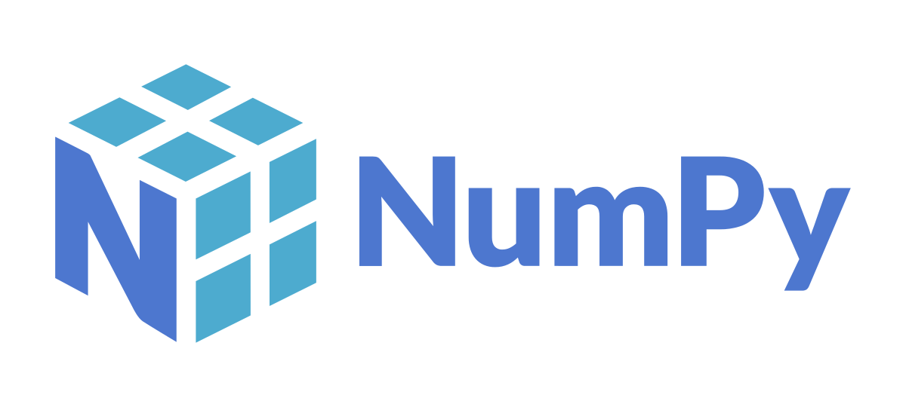

Scientific Computing Libraries in Python
Pandas (Data structures & tools)
1. Scientific Computing Libraries
NumPy (Arrays & matrices)
SciPy (Integrals, solving differential equations, optimisation)
Notes:
CLICE 1 <We have divided the Python data analysis libraries into three groups.>
CLICE 2 <Pandas is another great library that can enhance your Python skills for data science. Like NumPy, it belongs to the family of SciPy open-source software and is available under the BSD free software license.
Pandas offer versatile and powerful tools for munging data structures and performing extensive data analysis. The library works well with incomplete, unstructured, and unordered real-world data—and comes with tools for shaping, aggregating, analysing, and visualising datasets.>
CLICE 3 <NumPy (short for Numerical Python) is one of the top libraries with valuable resources to help data scientists turn Python into a robust scientific analysis and modelling tool. The popular open-source library is available under the BSD license. It is the foundational Python library for performing tasks in scientific computing. NumPy is part of a more extensive Python-based ecosystem of open-source tools called SciPy.
The library empowers Python with concrete data structures to perform effortlessly multi-dimensional arrays and matrices calculations. Besides its uses in solving linear algebra equations and other mathematical calculations, NumPy is a versatile multi-dimensional container for different generic data types.
CLICE 4 <SciPy includes functions for some advanced math problems as listed on this slide, as well as data visualisation.>

Slide 3
Question
What is the primary instrument used in Pandas?
Arrays
Dataframes
Matrices
Notes:
CLICE 1 <Question
What is the primary instrument used in Pandas?
Arrays
Dataframes
Matrices>

Slide 4


Visualization Libraries in Python
Matplotlib
(plots & graphs, most popular)
2. Visualization
Libraries
Seaborn
(plots: heat maps, time series, violin plots)
Notes:
CLICE 1 <Python is an Interactive, Interpreted, Object-Oriented Programming Language that incorporates Exceptions, Modules, Dynamic Typing, Dynamic Binding, Classes, High-level Dynamic Data Types, etc. It can also make system calls to almost all well-known Operating Systems.
Data visualization methods are the best way to communicate with others, showing them meaningful analysis results.>
CLICE 2 <Matplotlib is one of the most popular cross-platform Data Visualization and Graphical Plotting libraries for Python. It also has a numerical extension called NumPy. Matplotlib was developed by John Hunter and is currently seen as a robust Open-Source alternative to MATLAB. Developers can use this Python library to create numerous static, interactive, or animated data visualizations.
A Matplotlib script in Python can easily be structured such that a few lines of code are enough to generate a visual data plot.>
CLICE 3 <Seaborn is used for creating visualizations of statistical data. It is built on Matplotlib and provides a high-level interface for creating static, animated, and interactive statistical graphs. It has different functions for visualizing distributions, relationships between variables, and other types of statistical data.>

Slide 5
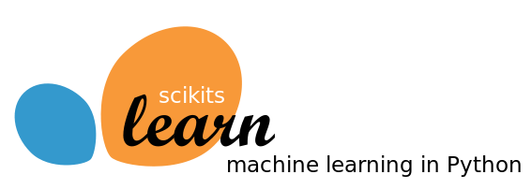
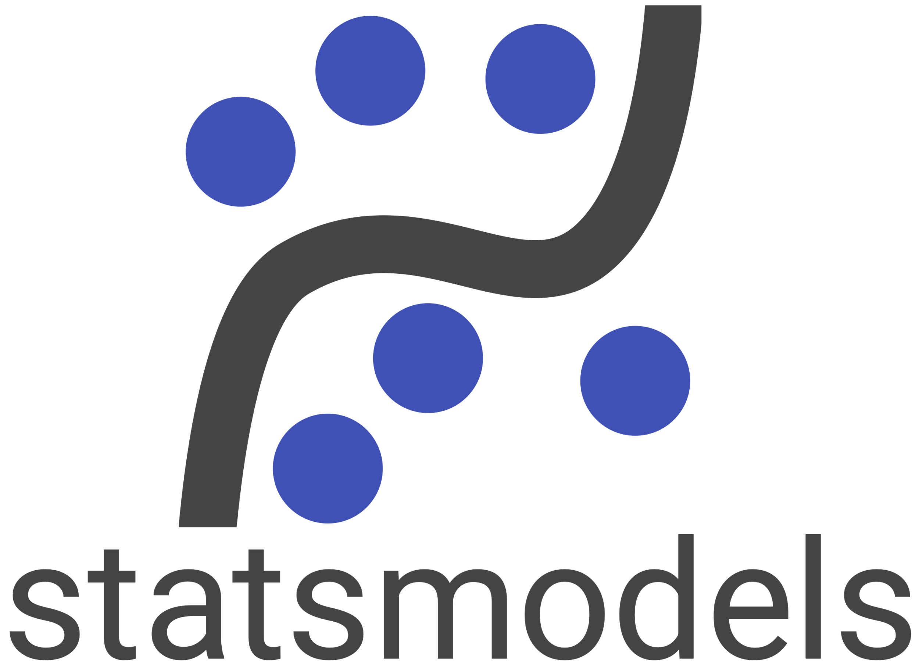
Algorithmic Libraries in Python
Scikit-learn
(Machine Learning: regression, classification,...)
3. Algorithmic
Libraries
Statsmodels
(Explore data, estimate statistical models, and perform statistical tests.)
Notes:
CLICE 1 <With machine learning algorithms, we can develop a model using our heart disease data set and get predictions.
Algorithmic libraries solve basic machine learning tasks to complex>
CLICE 2 <Here we present two packages>
CLICE 3 <scikit-learn is a library for machine learning in Python. It provides algorithms for classification, regression, clustering, and dimensionality reduction, as well as tools for evaluating the performance of these models. It also has functions for preprocessing data, such as scaling and imputing missing values.>
CLICE 4 <Statsmodels is a Python library for estimating and testing statistical models. It offers functions for fitting models to data and tools for conducting statistical tests and performing hypothesis tests. It is useful for linear regression, time series, and experimental data analysis.>

Slide 6
Question
What libraries do you use for data visualization?
matplotlib
numpy
scikit-learn
Notes:
CLICE 1 <Question
What libraries do you use for data visualization?>
matplotlib
numpy
scikit-learn

Slide 7

IBM Developer
Notes:
CLICE 1 <There are many Python data science libraries, each with features and capabilities. Whether you're working with numerical data, statistical data, or machine learning models, there is a Python library that can help you get the job done. By familiarizing yourself with them and their capabilities, you'll be well-equipped to tackle various data science tasks in Python.>

